Slide 1
Performance optimization in React
front.jit #1 (28.06.2022)

Slide 2

Maciej Kankowski
In Jit Team for 50 months 🤠
Frontend (React/Next/Vue + 🎨)
Mobile (🍏)
Internal projects / mentoring 🧑🏼‍🎓 👨🏼‍🎓
Travel, drones, books, cars 🚀

Slide 3

Today’s agenda
Short introduction to optimization
Is React fast?
Solving performance issues by examples

Slide 4

Performance optimization
Need for optimization
Measurement and tools
Choice of solution

Slide 5
Strategie optymalizacyjne
Runtime
Component extraction
Composition pattern
Virtualization
SSR
WebWorkers
„Lazy loading”
Immutability
…
Buildtime
Webpack, Vite, Rollup, ESBuild, Browserify
Production vs Debug flavor
Bundle size analyzer, e.g. webpack-bundle-analyzer
„Code splitting”, e.g.. multiple app entry points
„Lazy loading” – for routes and components
„Tree shaking” – unused code removal

Slide 6
React is FAST! 🚀

Slide 7
React is FAST! 🚀
*not always

Slide 8
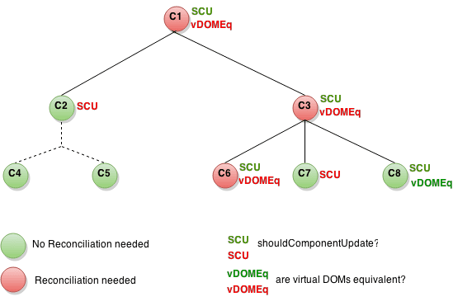
React
Virtual DOM
Key attribute
Memoization
https://reactjs.org/docs/optimizing-performance.html

Slide 9
useMemo
In the future, React may choose to “forget” some previously memoized values and recalculate them on next render, e.g. to free memory for offscreen components. Write your code so that it still works without useMemo — and then add it to optimize performance.
We should also not use useMemo when the function returns a primitive value, such as a boolean or a string. Because primitive values are passed by value, not by reference, it means that they always remain the same, even if the component is re-rendered.
If you’re performing an operation that’s not expensive (think Big O notation), then you don’t need to memoize the return value. The cost of using useMemo may outweigh the cost of reevaluating the function.

Slide 10
useCallback
❌ “Every callback function should be memoized to prevent useless re-rendering of child components that use the callback function”
✅ Big list of items: Memoization of the row cell in memoized parent component to prevent re-renders (and avoid break of the parent memorization)

Slide 11
console.warn('Talk is cheap,
show me your code!')

Slide 12
Example #1: Unresponsive (slow) component
Performance issue | Potential solution
Slow or unnecessary reloading of a component that has not changed state | Trace the state flow, identify what affects the unnecessary render and fix the source of the problems
https://github.com/mackankowski/front.jit/tree/main/src/lectures/performance-optimization/samples/slow-component

Slide 13
Example #2: Slow-loading list/table
Performance issue | Potential solution
A lot of elements to be displayed at the same time (e.g. a multiline table with a form) | Virtualization („windowing”) vs. paginacja vs. lazy-loading…
https://github.com/mackankowski/front.jit/tree/main/src/lectures/performance-optimization/samples/virtualized-table

Slide 14
Podsumowanie
Optimization – when needed
Using tools for specific problem resolving
One issue = many solutions
Performance optimizations are not free. They ALWAYS come with a cost but do NOT always come with a benefit to offset that cost.
Kent C. Dodds

Slide 15


Slide 16
Links
Articles:
https://reactjs.org/docs/optimizing-performance.html
https://reactjs.org/docs/hooks-reference.html#usememo
https://dmitripavlutin.com/use-react-memo-wisely/
https://dmitripavlutin.com/dont-overuse-react-usecallback/
https://overreacted.io/before-you-memo/
https://kentcdodds.com/blog/usememo-and-usecallback
https://blog.logrocket.com/rethinking-hooks-memoization/
https://medium.com/@paularmstrong/twitter-lite-and-high-performance-react-progressive-web-apps-at-scale-d28a00e780a3
https://www.patterns.dev/posts/virtual-lists/
https://blog.logrocket.com/guide-performance-optimization-webpack/ https://brycedooley.com/debug-react-rerenders/
Tools:
Chrome DevTools Profiler with "Why did this render" feature https://reactjs.org/docs/profiler.html
https://github.com/welldone-software/why-did-you-render
https://gist.github.com/mackankowski/53843a02399f4dbac5b972624c24dc6b
https://github.com/bvaughn/react-window
https://github.com/bvaughn/react-window-infinite-loader

